Slide 1
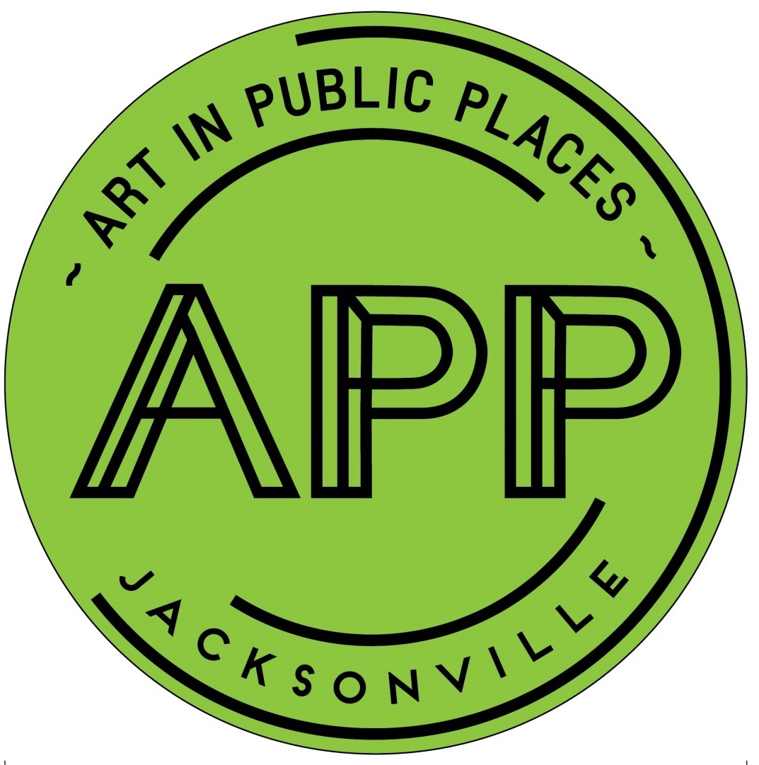
PROJECTS
Courthouse
Law & Liberty
Cuba Hunter Park
Winton Drive
Bob Hayes Sports Complex & Legends Community Center
Ed Ball Building

Slide 2
PROJECTS
Finances
Item | ($)
Courthouse | 866,667.32
Law & Liberty | Private
Cuba Hunter Park | 55,435.00
Winton Drive | 75,000.00
Bob Hayes Sports Complex & Legends Community Center | 42,136.35
Ed Ball Building | 16,021.31
PROJECT TOTALS | 1,055,259.98

Slide 3
PROJECTS
Art Selection
Process
A national, regional, or local CALL TO ARTISTS will go out through the Café online system.
Finalists will be selected and then come to Jacksonville, meet with the public, stakeholders and the ASP for discussion, listening and information exchange about the culture, history, environmental concerns, geography, use of site, stakeholders’ feedback about the site and about how Duval County residents want to be represented.
They will receive stipends to then create designs based on their research and the ASP will select the finalist and negotiate details about the design if necessary.
The ASP will then review the design proposals and make a recommendation to the APP Committee, who will approve and finalize the artist’s contract with the city.

Slide 4
COUNCIL MEMBERS
City Council Members
District 1 | Joyce Morgan | District 8 | Katrina Brown
District 2 | Al Ferraro | District 9 | Garrett L. Dennis
District 3 | Aaron L. Bowman | District 10 | Reginald L. Brown
District 4 | Scott Wilson | District 11 | Danny Becton
District 5 | President Lori N. Boyer | District 12 | Doyle Carter
District 6 | Matt Schellenberg | District 13 | Bill Gulliford
District 7 | Reggie Gaffney | District 14 | Jim Love
At-Large Council Members
Group 1 | Anna Lopez Brosche | Group 4 | Greg Anderson
Group 2 | Vice President John R. Crescimbeni | Group 5 | Samuel Newby
Group 3 | Tommy Hazouri

Slide 5
COURTHOUSE
Jacksonville: Where Florida

Slide 6
COURTHOUSE
Site Info & Contacts
Council Members at Large:
Anna Lopez-Brosche
Assistant: Jeneen Sanders
Vice President Crescimbeni
Assistant: Nikki Evans
Tommy Hazouri
Assistant: Haleigh Hutchinson
Greg Anderson
Assistant: Leeann Kreig
Samuel Newby
Assistant: Chiquita Moore
501 West Adams Street, Jacksonville, FL 32202
Planning District 1
Council District 7
Councilmember :
Reggie Gaffney
Assistant:
Sirretta Williams

Slide 7
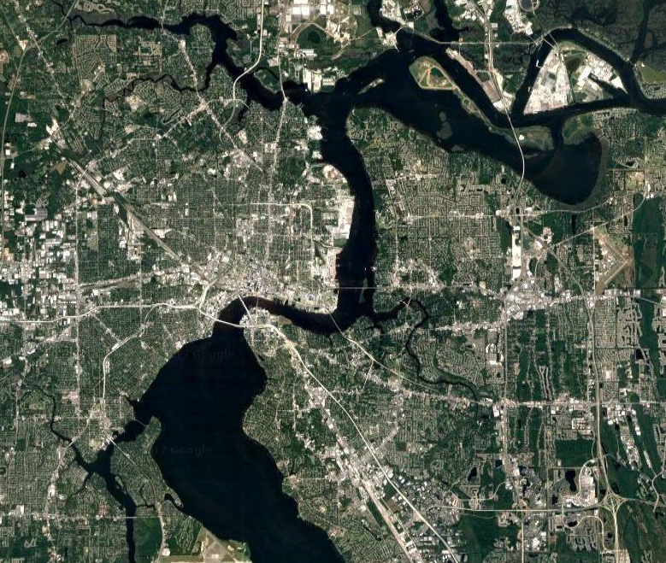
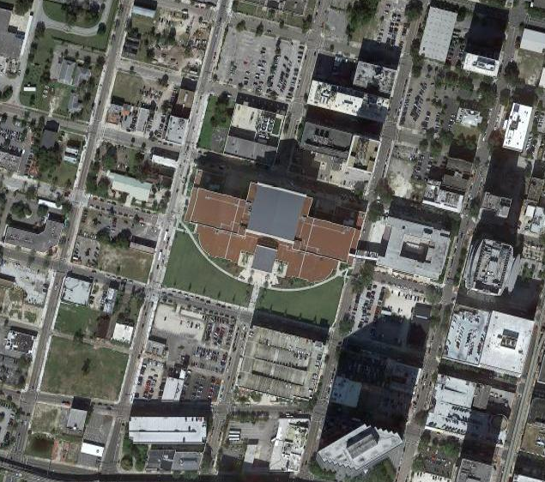
501 West Adams Street, Jacksonville, FL 32202
Planning District 1
COURTHOUSE
Neighborhood
Council District 7
Site

Slide 8
Shotgun Housing
COURTHOUSE
Neighborhood Details
Masonic Lodge
Duval County Courthouse
Federal Courthouse
Everbank Building

Slide 9
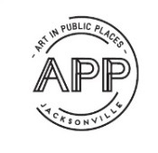
LEGISLATION
The nature of the Courthouse prevents general access to the public at large, so the stakeholders focused on the placement of artwork around the exterior of the building providing the greatest public exposure to area business, visitors and motor vehicle traffic.
BJP DUVAL COUNTY COURTHOUSE PUBLIC ART

Slide 10
COURTHOUSE FEATURES
The fifth Duval County Courthouse constructed, the original was built in 1825.
$245-million facility
Seven-story, 800,000-sq-ft concrete-framed building with a facade of precast concrete panels and glass.
Contains 51 courtrooms, 70+ judicial offices and space for court administration, clerk of courts and corrections.
BJP DUVAL COUNTY COURTHOUSE PUBLIC ART

Slide 11
SCOPE OF PROJECT
Based on feedback from previous Stakeholders’ Meetings and Courthouse Blog, the ASP will be looking for iconic, monumental artwork for the exterior of the Courthouse.
The APP tries to avoid “plop art” and instead seeks to integrate works into the site. Each project site goes in a specific direction based on that context.
Overall mission is for each project to be unified with the APP collection that currently exists, intending to keep a focus on the aesthetic nature that is being established in this city collection.
The locations and the types of projects that the APP undertakes are ideally intended for 24-hour access. A work out front would be illuminated, it would be a space that stays activated day or night.
BJP DUVAL COUNTY COURTHOUSE PUBLIC ART

Slide 12
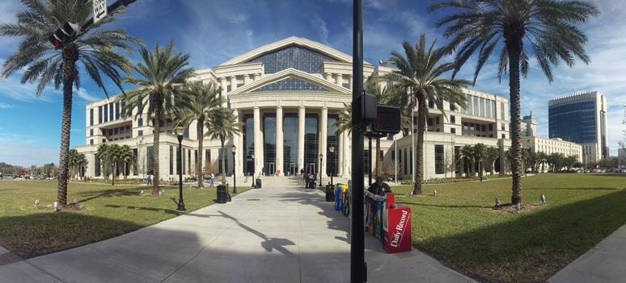
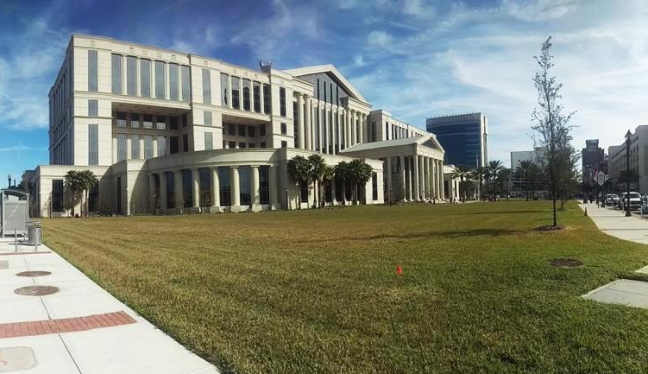
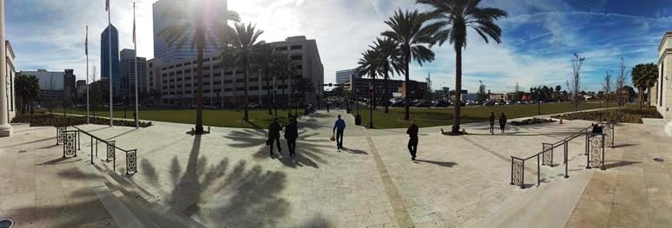
ELIGIBLE EXTERIOR SITE LOCATIONS
BJP DUVAL COUNTY COURTHOUSE PUBLIC ART

Slide 13
Art selection panel (ASP)
By City ordinance, the ASP consists of nine people who are representative of various stake holding. The Courthouse Art Selection Panel consists of the following members:
APPC member: David Engdahl (ASP Chair) Representative of the Site: Circuit Judge Hugh Carithers Architect Representative: Tom Rensing, KBJ Architects Community Representative: Anthony Butler, E3 Business Group Community Representative: C/M Reggie Gaffney, District 7 Community Representative: Lydia Stewart, former curator for Ritz Theatre CAO Appointed COJ Representative, Mayor’s Office: Kerri Stewart, Chief of Staff Artist/Art Professional/Educator: Dustin Harewood Artist/Art Professional/Educator: Jim Draper, UNF Gallery Director
BJP DUVAL COUNTY COURTHOUSE PUBLIC ART

Slide 14
Community outreach
BJP DUVAL COUNTY COURTHOUSE PUBLIC ART
Launched in the summer of 2015, the Cultural Council posted a COURTHOUSE PUBLIC ART BLOG— a forum where members of the community can make comments on the things that are important to them with regard to the public art for the Duval County Courthouse.
STAKEHOLDERS & MEMBERS OF THE PUBLIC were asked to invite all in the community to make comments via email.
A SITE TOUR was held and attendees were given an overview of the project

Slide 15
Stakeholders comments
The artwork should reflect images of the human body.
Use local artists
Do not rush into the project without enough money to address the plaza, and spend some years raising more money first.
Ensure that lighting is included for the artwork and that the art is visible and attracting at night so the plaza can also be utilized at night.
Artwork should be visible from the many highways in and out of downtown
Consider art that is reflective of the style of architecture of the building.
Consider traditional materials, such as bronze, though not necessarily a bronze monument.
Make sure the art also becomes a destination, like other great cities have
Commission art that bolsters Jacksonville as a thriving modern city
Include water elements or homage to the water surrounding the city
The 1 million dollars originally set aside for the landscaping/Monroe Street should be recovered and incorporated with the landscaper working in tandem with the artist selected
A good artist will be clever enough to be able to succeed in curating a project that will address all the important factors supplied by the site and the stakeholders.
Think outside of the safety zone
After discussion about whether there should be one iconic piece or two that work together as one piece, and whether the temporary bisecting sidewalks will remain, it was determined that because of the remaining question about the plaza landscaping still necessary and still outstanding, that the artist should be directed to unite the entire plaza in the best most iconic fashion possible.
Trust that the artist selected will be intelligent, observant and able to participate in the back and forth discussion with the selection panel about how to best address/reflect the important features that will best reflect Duval County.
BJP DUVAL COUNTY COURTHOUSE PUBLIC ART

Slide 16
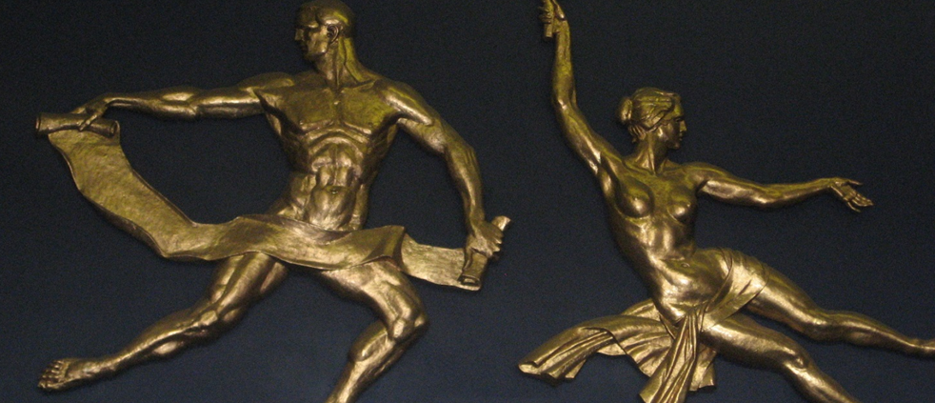
LAW & LIBERTY
Arts & Culture Begins.
Jacksonville: Where Florida

Slide 17
LAW & LIBERTY
Summary
Sculptures created by Sheldon Bryan
Installed in the old Courthouse – 1958
To be installed up high, interior of new Courthouse

Slide 18
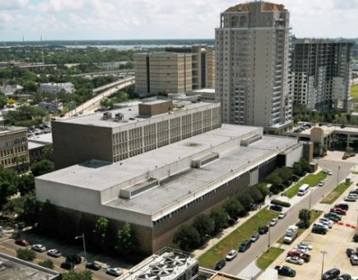
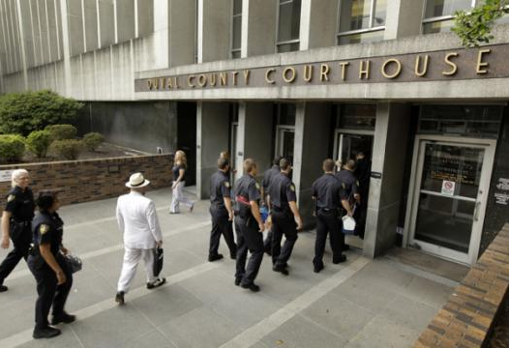
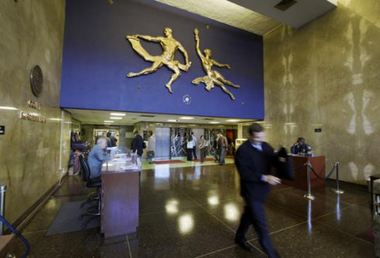
OLD DUVAL COUNTY COURTHOUSE
Photo credit by: Times-Union staff photographer Bob Self

Slide 19
LAW & LIBERTY
Site Info & Contacts
Council Members at Large:
Anna Lopez-Brosche
Assistant: Jeneen Sanders
Vice President Crescimbeni
Assistant: Nikki Evans
Tommy Hazouri
Assistant: Haleigh Hutchinson
Greg Anderson
Assistant: Leeann Kreig
Samuel Newby
Assistant: Chiquita Moore
501 West Adams Street, Jacksonville, FL 32202
Planning District 1
Council District 7
Council Member:
Reggie Gaffney
Assistant:
Sirretta Williams

Slide 20
501 West Adams Street, Jacksonville, FL 32202
Planning District 1
LAW AND LIBERY
Neighborhood
Council District 7
Site

Slide 21
Shotgun Housing
LAW & LIBERTY
Neighborhood Details
Masonic Lodge
Duval County Courthouse
Federal Courthouse
Everbank Building

Slide 22
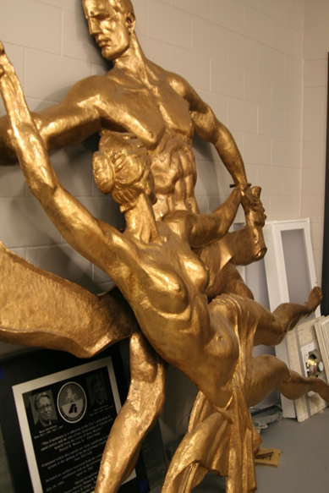
LAW & LIBERTY
Object Description
Two-component piece that was formerly installed at the previous courthouse with Law staggered above Liberty as the two figures reach towards each other.
Originally the constellation of Libra was painted on the wall to which the bronze figures were attached.
Currently in storage.
Will be located out of reach, indoors

Slide 23
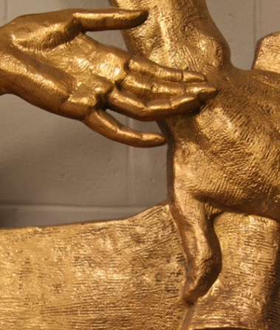
LAW & LIBERTY
Details
The surfaces appear to be a high polished bronze with a lacquer coating.
Law
Male figure
100” tall x 103” wide x 6” depth
Liberty
Female figure
94” tall x 112” wide x 6” depth

Slide 24
LAW & LIBERTY
Conservation
2 day treatment time
2 people needed
$500.00 materials cost (approx.)
$5,100.00 treatment cost (approx.)
Should be treated prior to re-installation

Slide 25
LAW & LIBERTY
Sheldon Bryan
Sheldon Byran is original artist
Graduated from Andrew Jackson High School
Bryan considered himself equally dedicated to oil painting and sculpture.
Law & Liberty was considered his largest work at its 1958 installation.

Slide 26
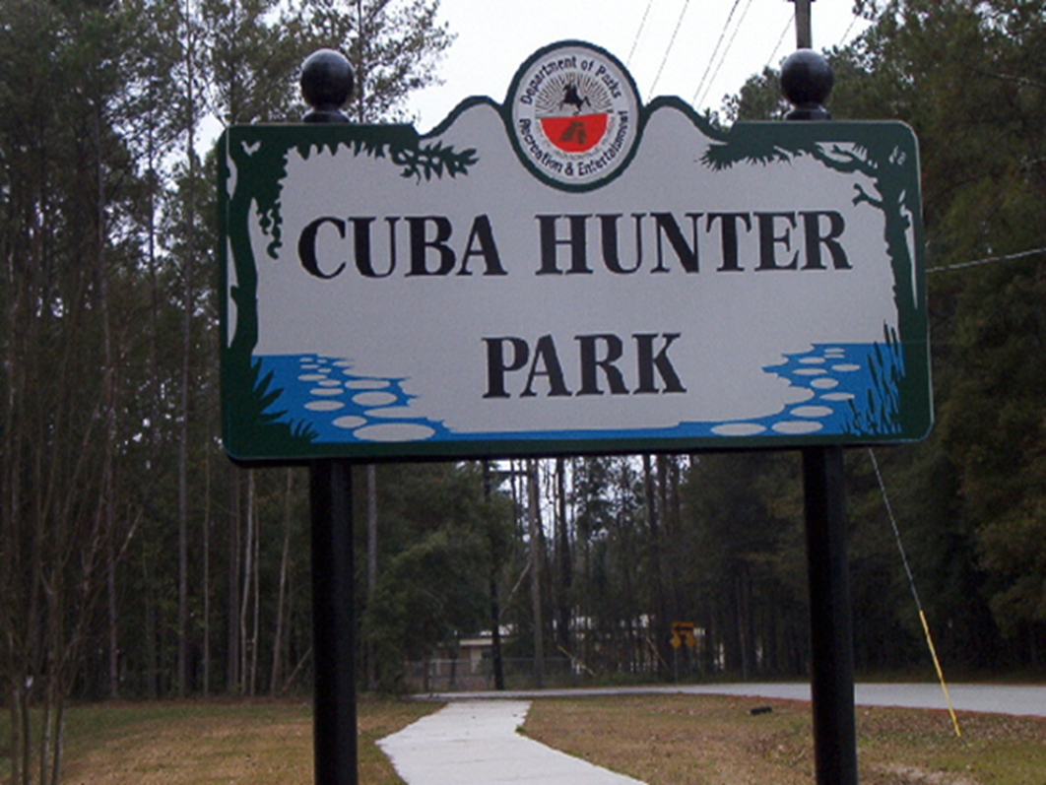
CUBA HUNTER PARK

Slide 27
CUBA HUNTER PARK
Park Features
10,000² ft. skatepark
Two Playscapes
Multi-use athletic field
3.50 acres of wetlands
0.25 mile boardwalk
Gymnasium
Picnic tables and grills

Slide 28
CUBA HUNTER PARK
History
The property was originally owned by John Hunter, a retired Jacksonville Sheriff’s Officer.
The park was named after his daughter who died protecting her nephew from a drunk driver.
Cuba Hunter was a 32-year-old schoolteacher who was killed in downtown Jacksonville by a drunk driver in 1943.
She and her nephew, Sidney Hunter, had just stepped off of a city bus and were crossing the street when she spotted a car speeding toward them. She pushed her nephew toward the curb, thus saving his life, but was struck by the car herself.

Slide 29
CUBA HUNTER PARK
History Cont.
John Hunter, who owned the property, died in 1958. He donated the front portion to Duval County in 1950, envisioning it as a memorial to his daughter, according to Times-Union Stories. But at the time, the land was outside the city limits.
When the city failed to develop the park within 20- year period stipulated in his deed, the land reverted to his heirs. While head of the Greater Englewood Neighborhood Association, Suzanna Jenkins (who later served on the City Council) and other members began lobbying for the project in 1995. In 1997, the city purchased the entire site to develop a park.
City’s first skate park, opened in 2002

Slide 30
CUBA HUNTER PARK
Site Info & Contacts
Council Members at Large:
Anna Lopez-Brosche
Assistant: Jeneen Sanders
Vice President Crescimbeni
Assistant: Nikki Evans
Tommy Hazouri
Assistant: Haleigh Hutchinson
Greg Anderson
Assistant: Leeann Kreig
Samuel Newby
Assistant: Chiquita Moore
4380 Bedford Road, Jacksonville, FL 32207
Planning District 3
Council District 5
Council President
Lori Boyer
Assistant:
Nicole Spradley

Slide 31
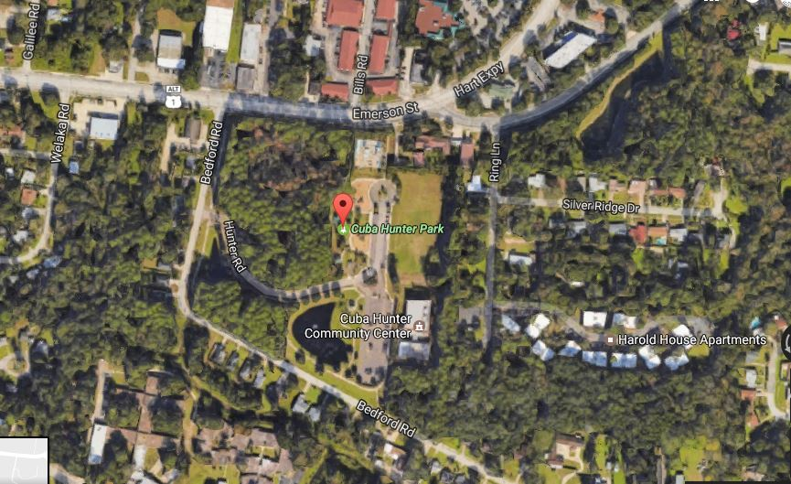
CUBA HUNTER PARK
Neighborhood
Site
4380 Bedford Road, Jacksonville, FL 32207
Planning District 3
Council District 5

Slide 32
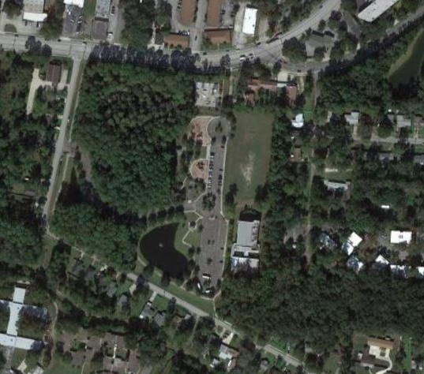
Ponderrosa Baptist Church
Hunter Park Baptist Church
Skate Park
CUBA HUNTER PARK
Neighborhood Details
Playscapes
Wetlands
Athletic Fields
Cuba Hunter Community Center
Apartments
Single Family Homes

Slide 33
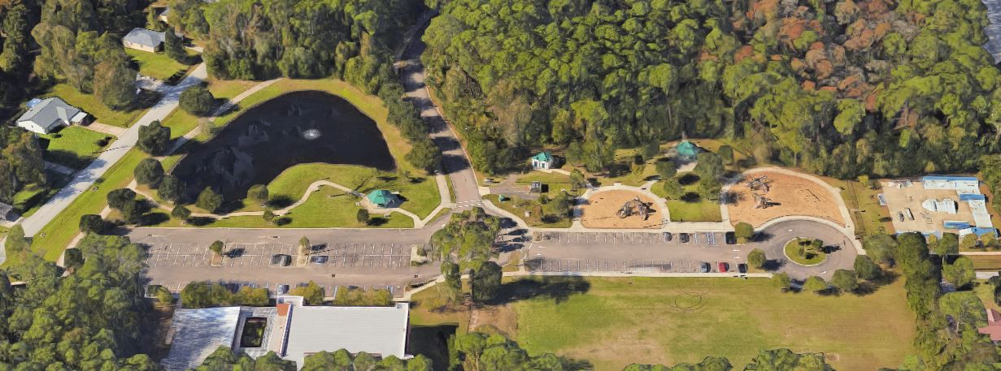
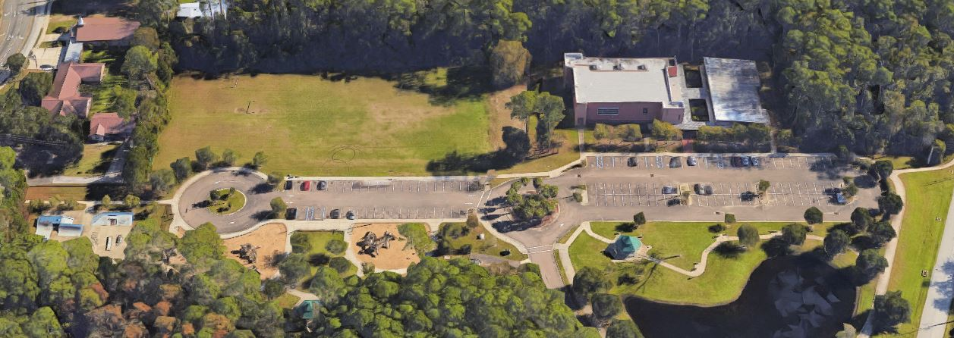
CUBA HUNTER PARK
Aerial
West View
East View

Slide 34
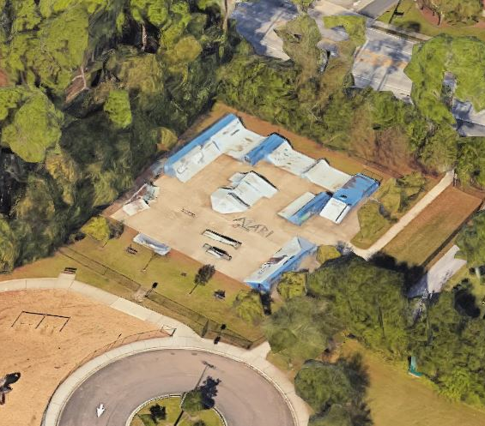
CUBA HUNTER PARK
Skate Park

Slide 35
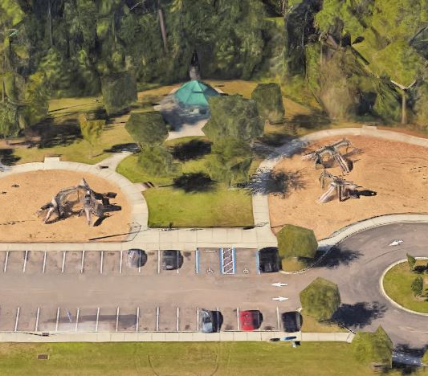
CUBA HUNTER PARK
Playscapes

Slide 36
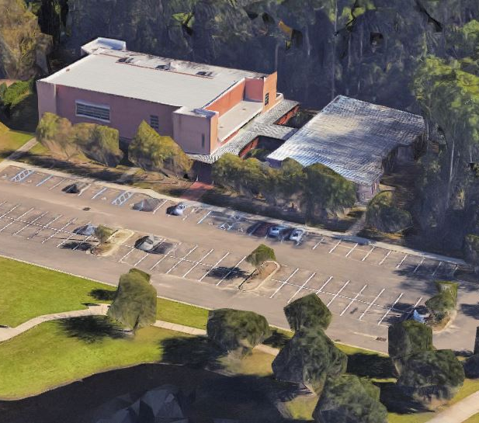
CUBA HUNTER PARK
Community Center

Slide 37
CUBA HUNTER PARK
Wetlands

Slide 38
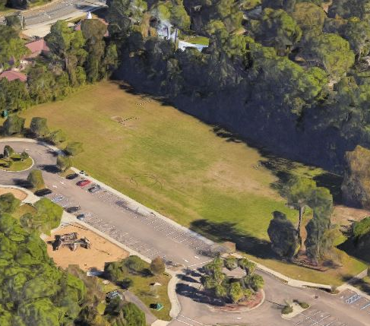
CUBA HUNTER PARK
Athletic Fields

Slide 39
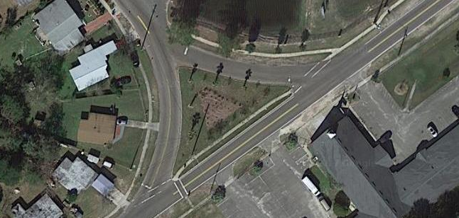
WINTON DRIVE
Arts & Culture Begins.
Jacksonville: Where Florida

Slide 40
WINTON DRIVE
Summary
Project sponsored by Councilman Reginald Brown
Island is roughly 11,000² ft.
St. Paul Missionary Baptist Church has agreed to maintain site.
Sculptural Work Requirements:
Must appeal to all three schools
Cannot be aluminum
Cannot include benches
Cannot impair visibility of intersections

Slide 41
WINTON DRIVE
Other Information
May focus on neighborhood artists
Engage community through CPAC Meetings
Public farms and gardens has been suggested
Solar powered lighting has been suggested
Request Community Representative Seat to be filled by Ribault High School student
City Department that oversees property will need to be identified
Community Blog will be established

Slide 42
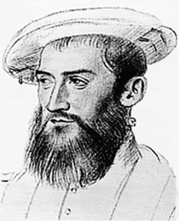
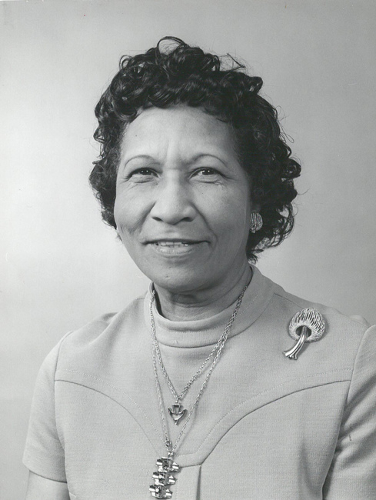
WINTON DRIVE
History
A
B
Jean Ribault
Winton
Sallye B. Mathis
French
Huguenot
Colonist
One of the first women & black individuals elected to city council
Teacher and Dean
Civic Activist
TBD
A: Smith College
B: Times Union Archives

Slide 43
WINTON DRIVE
Sports & Recreation
Inside and outside of school
Ribault High School = Trojans
Cross Country, Track & Field, Soccer, Swimming
Boys Basketball = Trojans
Girls Basketball = Lady Trojans
Football = Trojans
Rivalry with Raines

Slide 44
WINTON DRIVE
Education
3 public schools
Student demographic is 93% black on average
Roughly 2500 students and faculty
Ribault High School founded in 1957
Specialty Programs at Ribault High
Military Sciences (MCJROTC)
Early College
Aviation
Finance

Slide 45
WINTON DRIVE
Other Info
JTA Route 22 is immediate
JTA Routes 3 and 4 are in neighborhood
Average of 165 weekday
Single family homes
Christian presence in neighborhood

Slide 46
WINTON DRIVE
Site Info & Contacts
5130 Soutel Drive, Jacksonville, FL 32208
Council Members at Large:
Anna Lopez-Brosche
Assistant: Jeneen Sanders
Vice President Crescimbeni
Assistant: Nikki Evans
Tommy Hazouri
Assistant: Haleigh Hutchinson
Greg Anderson
Assistant: Leeann Kreig
Samuel Newby
Assistant: Chiquita Moore
Planning District 5
Council District 10
Council Member:
Reginald Brown
Assistant:
Gerrie Ford-Hardin

Slide 47
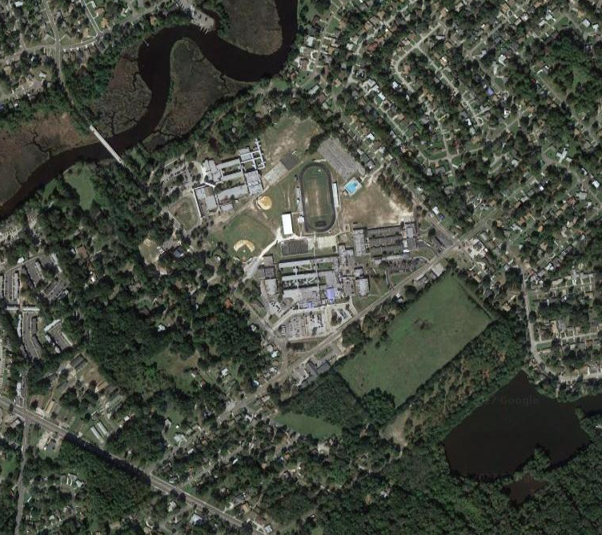
5130 Soutel Drive, Jacksonville, FL 32208
Planning District 5
Council District 10
WINTON DRIVE
Neighborhood
Site

Slide 48
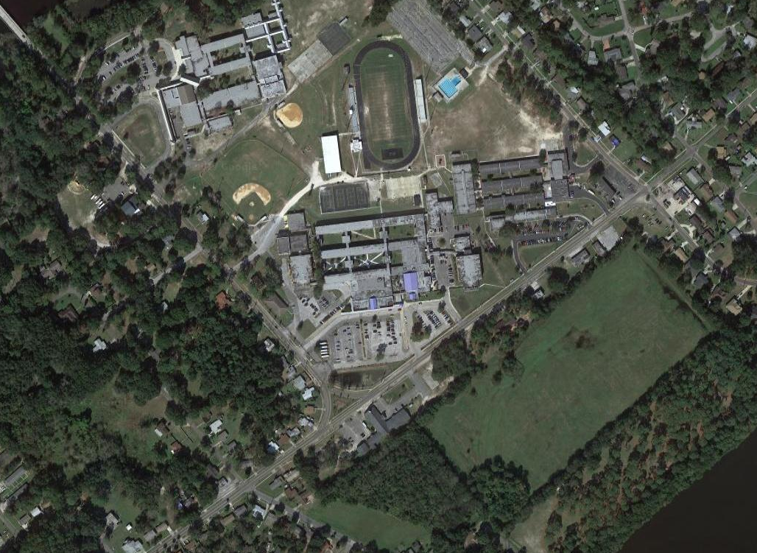
Single Family Homes
Ribault Middle
WINTON DRIVE
Neighborhood Details
Sallye B. Mathis Elementary
Ribault High
Small Businesses
Winton Park Drive
Site
St. Paul Missionary Baptist Church

Slide 49
C
A
Site
B
WINTON DRIVE
Approaching Site
Site
Site
Site
Small Businesses
Winton Park Drive
A
B
C

Slide 50
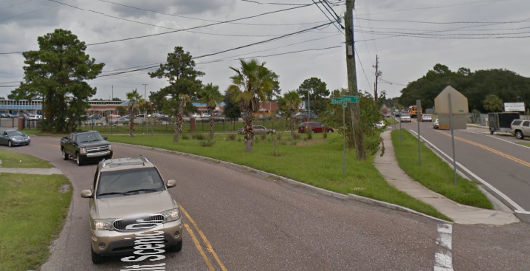
Site
A
WINTON DRIVE
Site
A

Slide 51
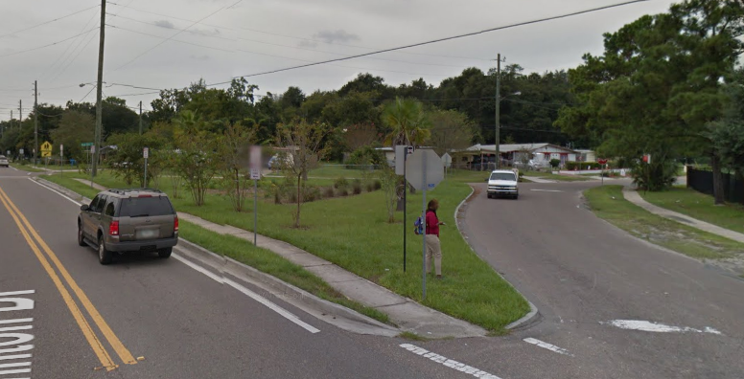
Site
A
WINTON DRIVE
Site
A

Slide 52
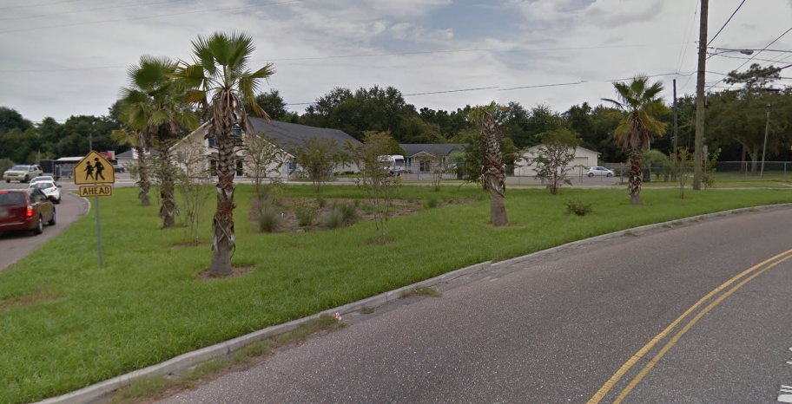
A
Site
WINTON DRIVE
Site

Slide 53
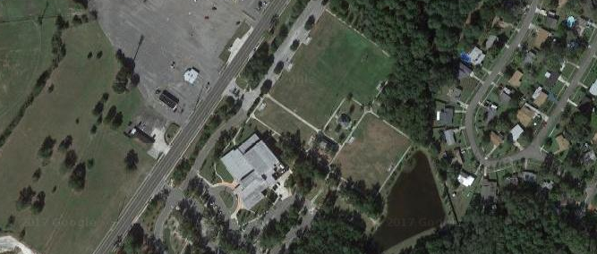
BOB HAYES SPORTS COMPLEX & LEGENDS COMMUNITY CENTER
Arts & Culture Begins.
Jacksonville: Where Florida

Slide 54
BOB HAYES & LEGENDS
Usage
Local and regional events
Summer camps
Local and regional athletics
Emergency shelter

Slide 55
BOB HAYES & LEGENDS
Amenities
Soccer Fields
Football Field
Indoor Basketball Court
Elevated Track
Kitchen
Community Center
Computer Labs

Slide 56
BOB HAYES & LEGENDS
Site Info & Contacts
5130 Soutel Drive, Jacksonville, FL 32208
Council Members at Large:
Anna Lopez-Brosche
Assistant: Jeneen Sanders
Vice President Crescimbeni
Assistant: Nikki Evans
Tommy Hazouri
Assistant: Haleigh Hutchinson
Greg Anderson
Assistant: Leeann Kreig
Samuel Newby
Assistant: Chiquita Moore
Planning District 5
Council District 10
Council Member:
Reginald Brown
Assistant:
Gerrie Ford-Hardin

Slide 57
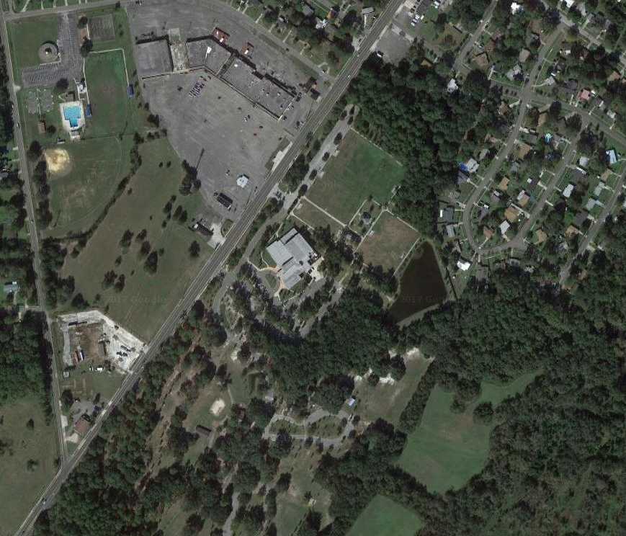
5130 Soutel Drive, Jacksonville, FL 32208
Planning District 5
Council District 10
BOB HAYES & LEGENDS
Neighborhood
Council Member:
Reginald Brown
Site
Site
Assistant:
Gerrie Ford-Hardin

Slide 58
Strip Mall
Charles Boobie Clark Park & Pool
BOB HAYES & LEGENDS
Neighborhood Details
Bob Hayes Sports Complex
Single Family Homes
Legends Community Center
Lonnie C. Miller Regional Park

Slide 59
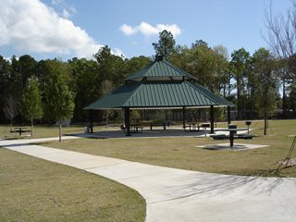
BOB HAYES & LEGENDS
Sports Complex

Slide 60
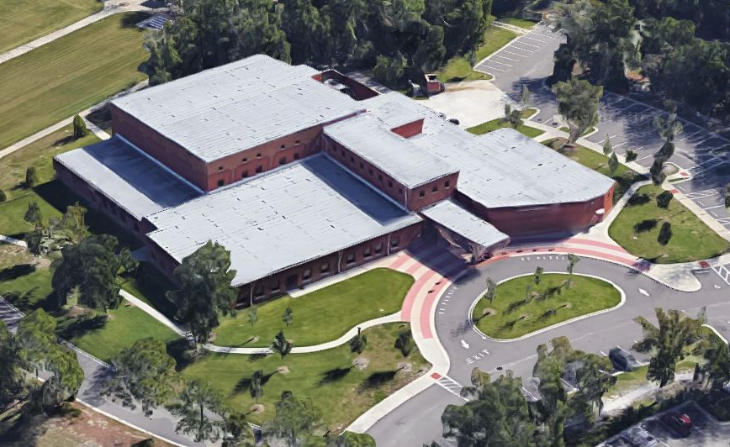
BOB HAYES & LEGENDS
Legends Center

Slide 61
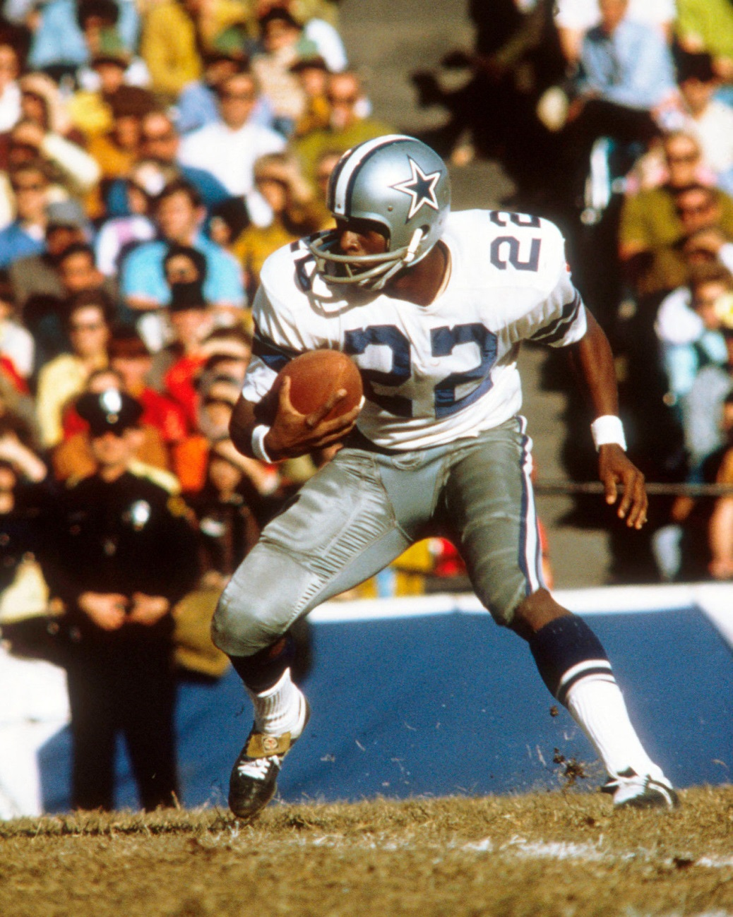
BOB “BULLET BOB” HAYES
History
Once considered the world's fastest man
World records in the 60-yard, 100-yard, 220-yard, and Olympic 100-meter dashes.
Only athlete to win a Superbowl Ring and Olympic Gold Medal

Slide 62
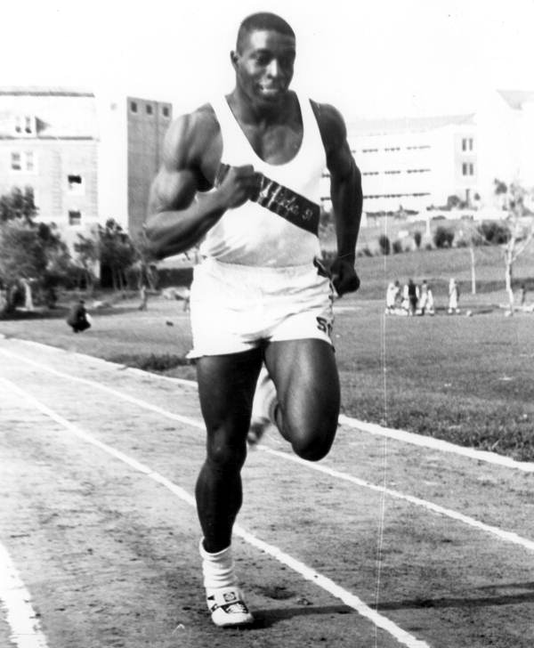
BOB “BULLET BOB” HAYES
History Cont.
Born in Jacksonville, FL - 1942
Attended Gilbert High School, playing for the Panthers football
Won Florida High School Student Association Black School State Championship against Ft. Lauderdale 14-7 with an 11,000 person audience
Achievement went unacknowledged during segregation – not recognized until 50 years later
died of kidney failure, after battling prostate cancer and liver ailments in Jacksonville - 2002

Slide 63
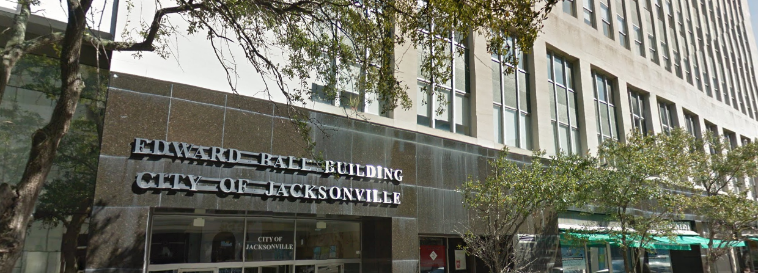
ED BALL BUILDING
Jacksonville: Where Florida

Slide 64
ED BALL BUILDING
Site Info & Contacts
Council Members at Large:
Anna Lopez-Brosche
Assistant: Jeneen Sanders
Vice President Crescimbeni
Assistant: Nikki Evans
Tommy Hazouri
Assistant: Haleigh Hutchinson
Greg Anderson
Assistant: Leeann Kreig
Samuel Newby
Assistant: Chiquita Moore
223 West Adams Street, Jacksonville, FL 32202
Planning District 1
Council District 7
Council Member:
Reggie Gaffney
Assistant:
Sirretta Williams

Slide 65
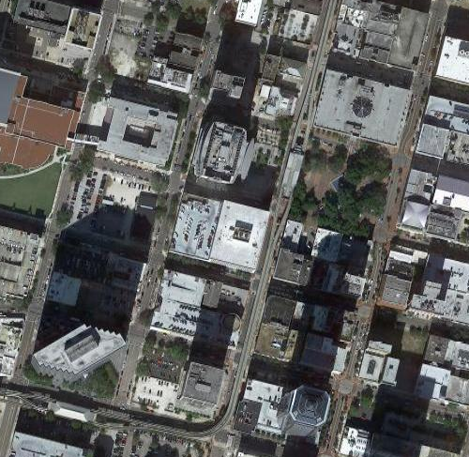
223 West Adams Street, Jacksonville, FL 32202
Planning District 1
ED BALL BUILDING
Neighborhood
Council District 7
Site

Slide 66
City Hall
ED BALL BUILDING
Neighborhood Details
Federal Courthouse
Hemming Park
Ed Ball Building
Everbank Building
Skyway System

Slide 67
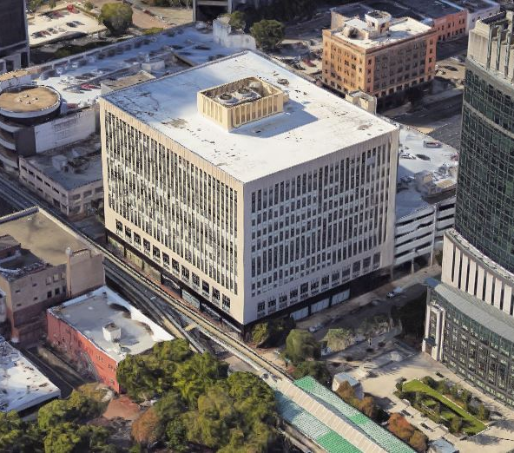
ED BALL BUILDING
Aerial

