Slide 1
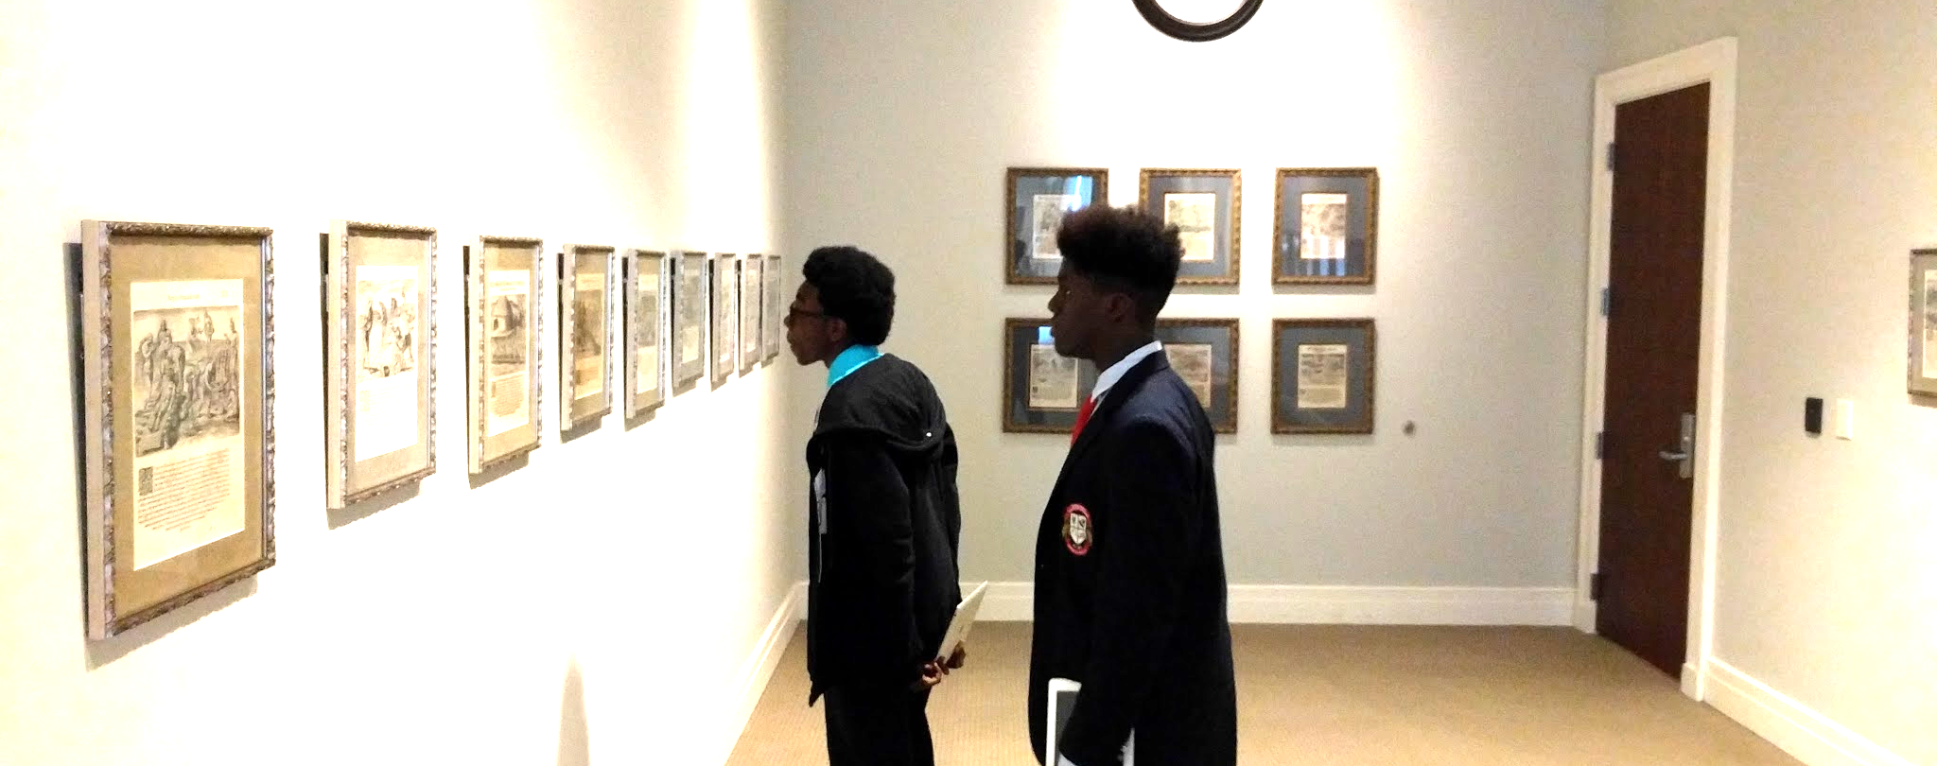
CULTURAL EQUITY COMMITMENT
Cultural Council of Greater Jacksonville • November 21, 2016

Slide 2
CENSUS

Slide 3
CSG BOARDS
There is work to do.

Slide 4
HOW DO WE DETERMINE?
First the baseline.

Slide 5
HOW DO WE DETERMINE?
First the baseline.

Slide 6
HOW DO WE DECIDE?
Are you working on it?

Slide 8
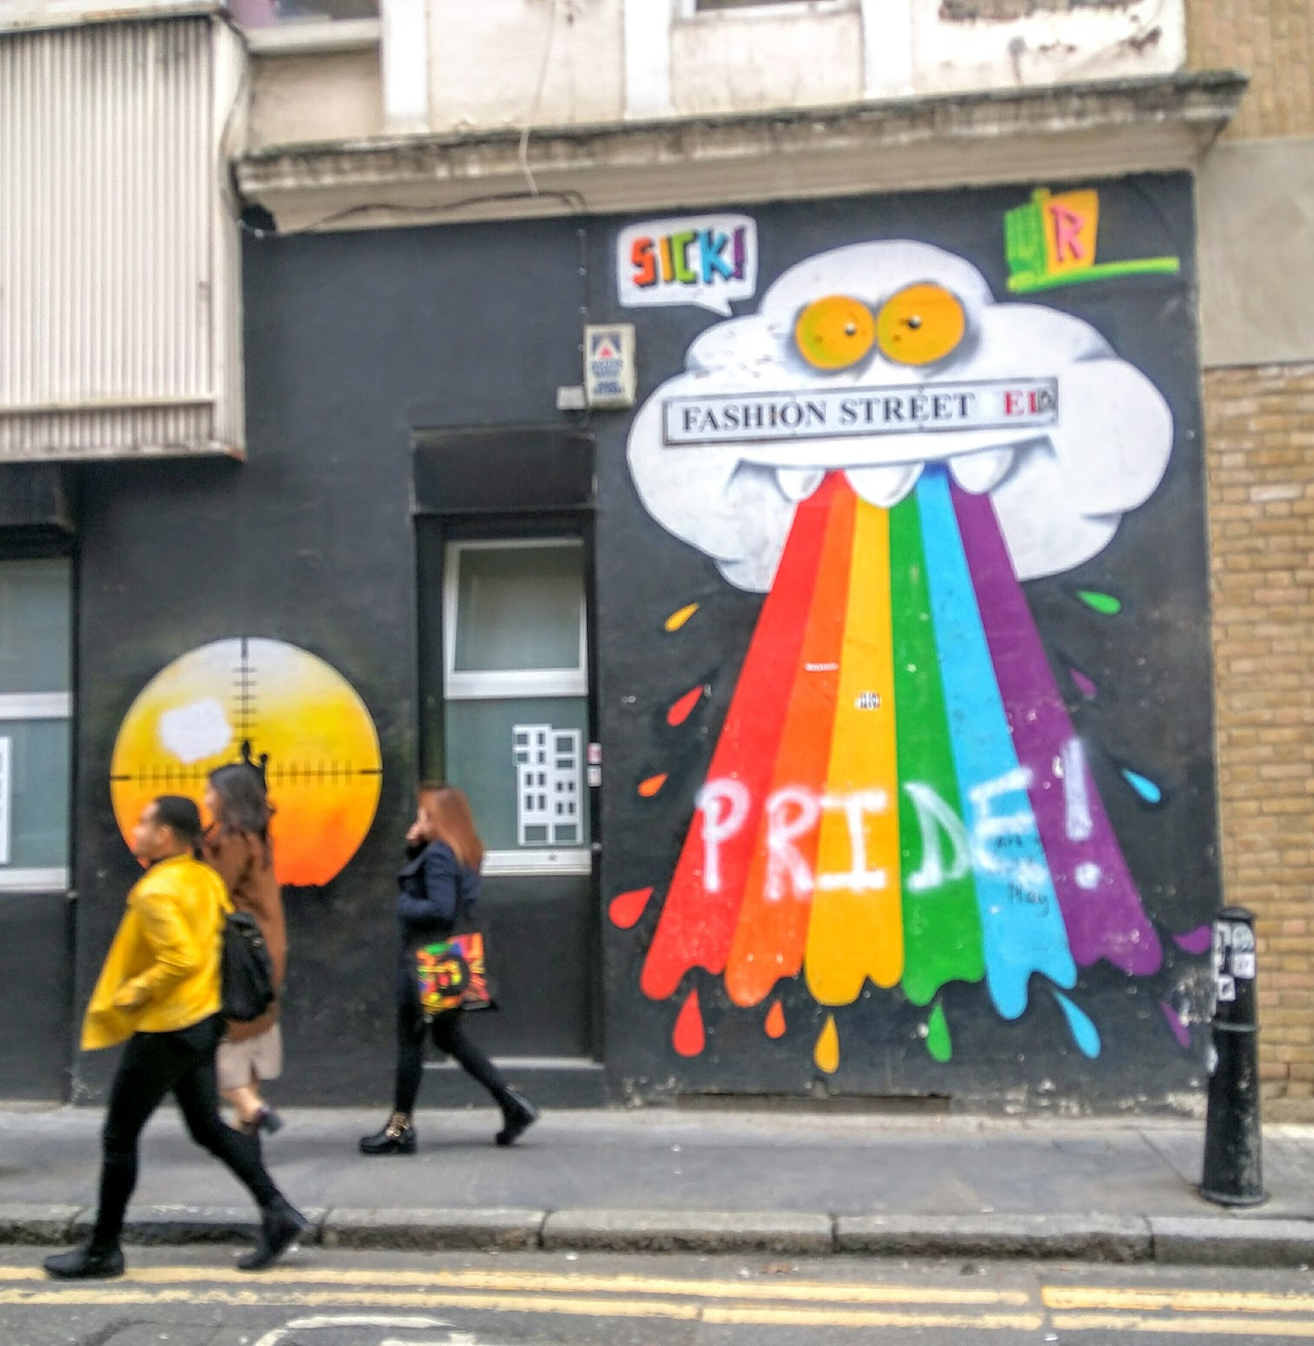
Cultural Equity Statement
To support a full creative life for all, the Cultural Council of Greater Jacksonville commits to championing policies and practices of cultural equity that empower a just, inclusive, equitable city.

Slide 9
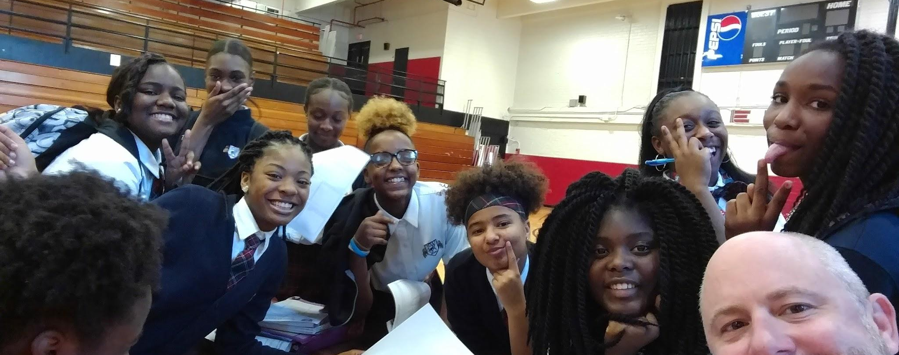
Cultural Service Internships
CulturalServiceInternships.com

Slide 10
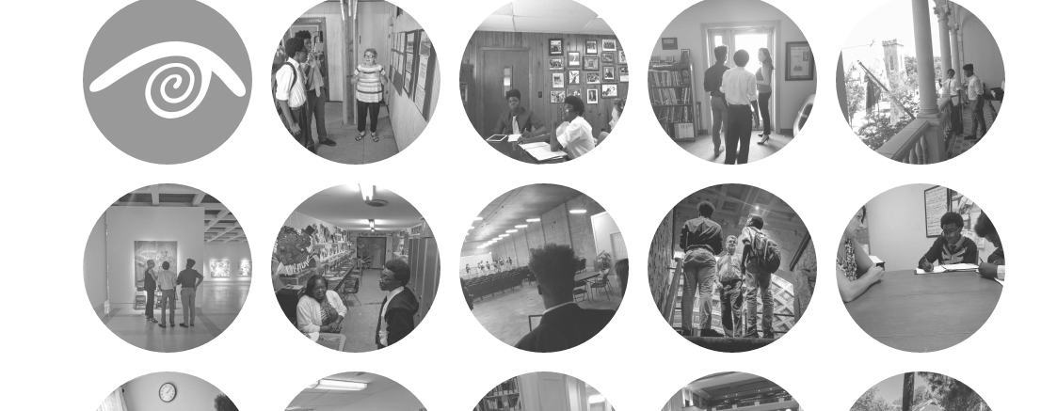
25 Paid Internships in 2017
Access and Awareness / Pipeline of Talent and Interest

Slide 11
WHAT WILL YOUR INTERN DO?
Forms and suggestions distributed in January. Convening at School in Spring.

Slide 12
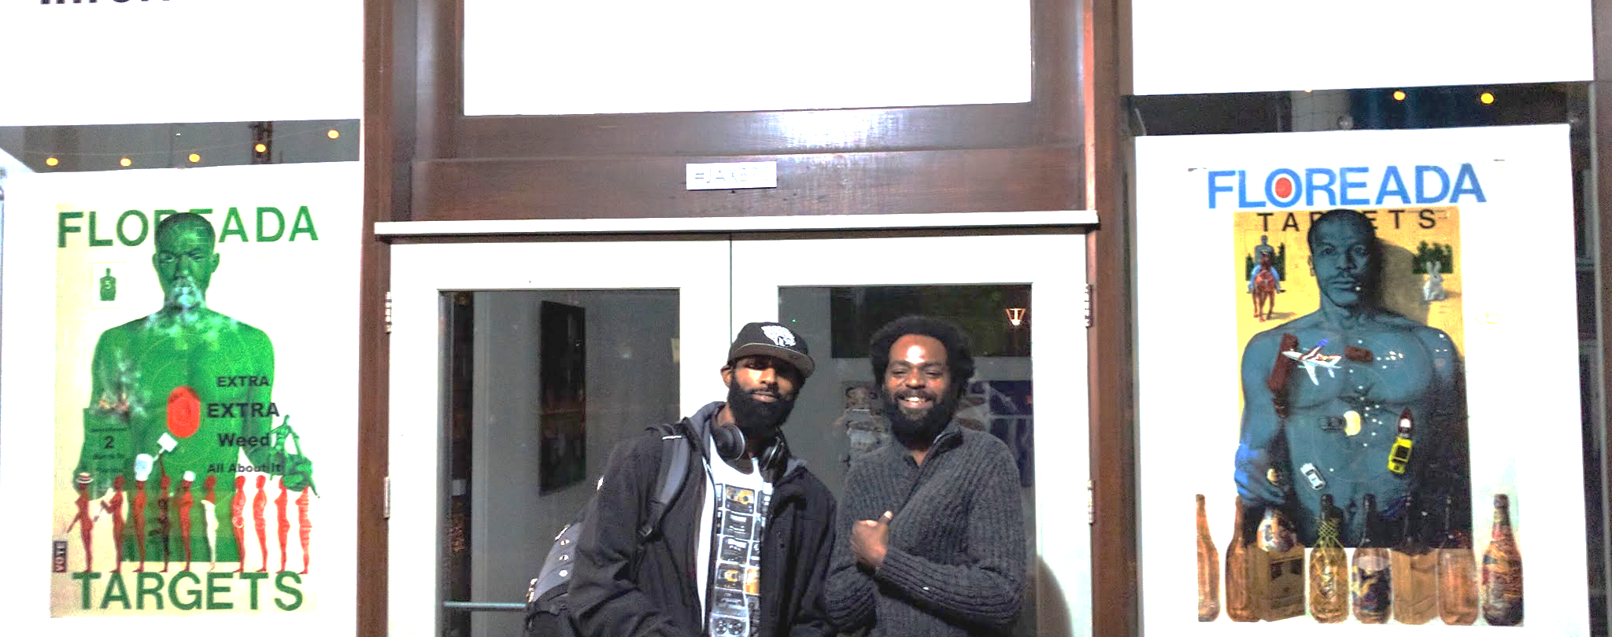
Cultural Export Grants
Exporting Local Artists to Inspiring New Opportunities

Slide 13
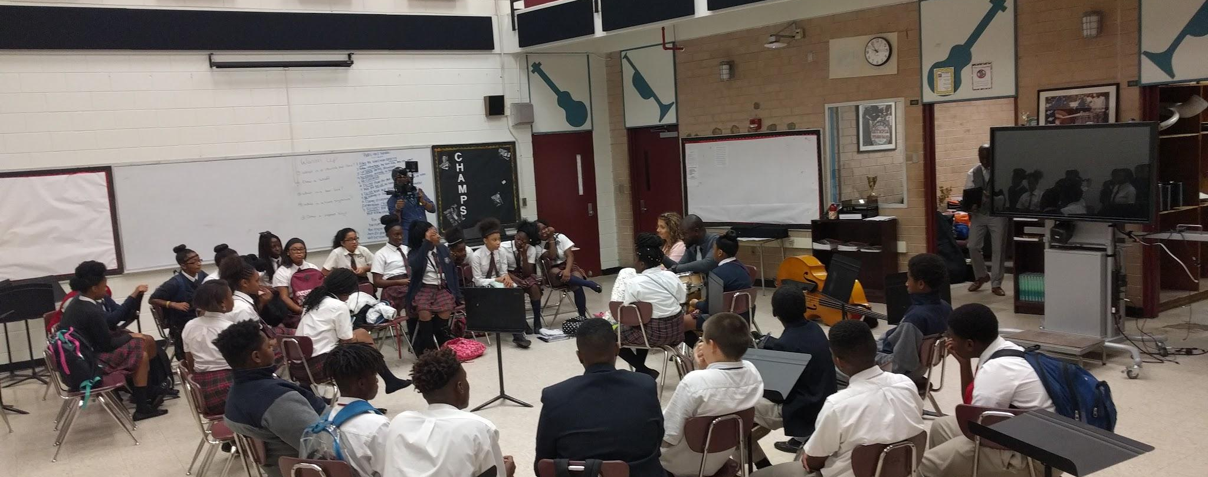
John Lumpkin’s Jazz Discovery Series & Clinics
Along with in School Performances

Slide 14
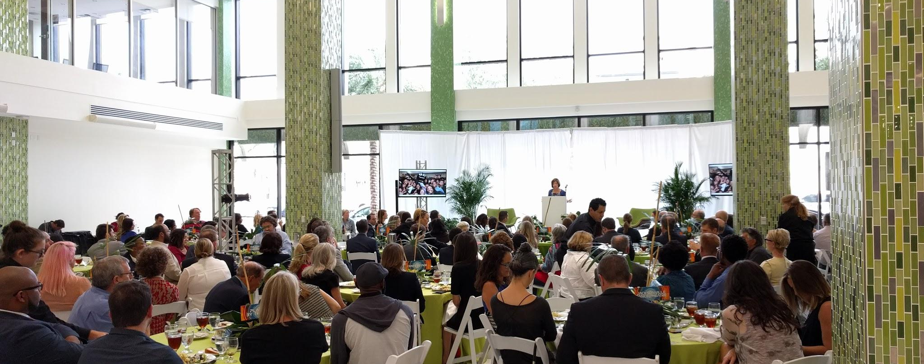
ARTS ALIVE GRANTS
More than $150,000 for Diverse & Inclusive Programming and Access to the Arts for ALL

Slide 15
Public Art in ALL Places
THREE Funded Projects on Jacksonville’s Northside + Lift Ev’ry Voice & Sing Park

Slide 16
NEXT STEP
Make the Statement

Slide 17
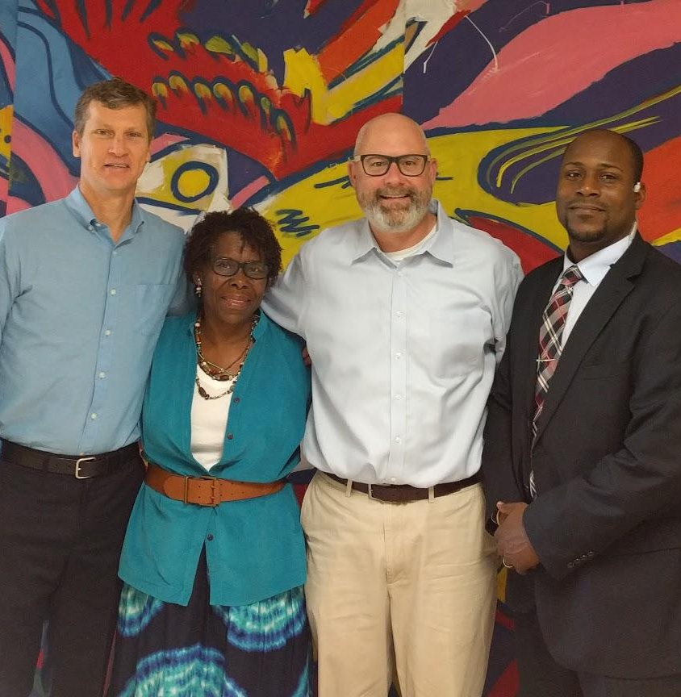
Cultural Equity Statement
To support a full creative life for all, the Cultural Council of Greater Jacksonville commits to championing policies and practices of cultural equity that empower a just, inclusive, equitable city.

